Slide 1
Chapter 1
History of recommendation system, Eliciting Ratings and other Feedback Contributions, Implicit and explicit Ratings, Recommender system functions.
Linear Algebra notation: Matrix addition, Multiplication, transposition, and
inverses; covariance matrices, Understanding ratings, Applications of recommendation systems, Issues with recommender system.
Notes:
Amazon
Netflix
Facebook friend

Slide 2
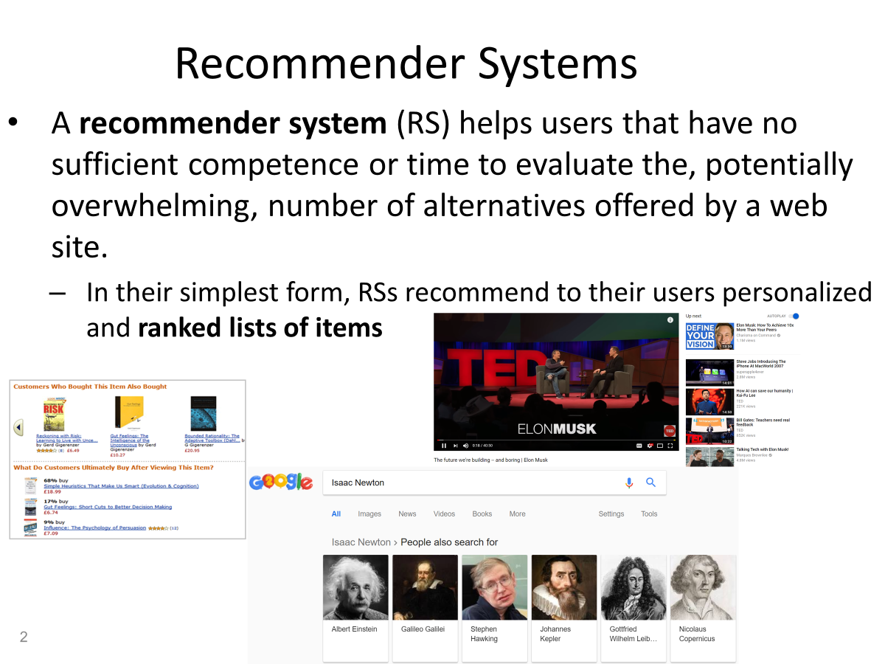

Slide 3
History of recommendation system
Early Systems (Pre-1990s):
The concept of recommendation systems can be traced back to early attempts to provide personalized recommendations in libraries and retail settings. Traditional methods involved human experts curating lists or suggesting items based on customers' preferences.
Collaborative Filtering (1990s):
The 1990s saw the rise of collaborative filtering, a technique where users are recommended items based on the preferences of users with similar tastes. GroupLens, a research project at the University of Minnesota in 1992, is often credited with pioneering collaborative filtering for movie recommendations.
Content-Based Filtering (1990s):
Content-based filtering emerged as an alternative approach, recommending items based on the user's historical preferences and the characteristics of items.
Pandora, a music recommendation service launched in 2000, used content-based methods to suggest songs based on musical features.
Netflix Prize (2006):
The Netflix Prize competition in 2006 marked a significant milestone, offering a substantial reward for improving Netflix's movie recommendation algorithm by 10%.
This competition spurred research and innovation in recommendation algorithms.

Slide 4
History of recommendation system
Introduction of Hybrid Models (2000s):
Hybrid recommendation systems, combining collaborative filtering and content-based filtering, gained popularity for their ability to provide more accurate and diverse suggestions.
Companies like Amazon and Netflix started incorporating hybrid approaches into their recommendation engines.
Matrix Factorization and Deep Learning (2010s):
Matrix factorization techniques gained prominence, enabling recommendation systems to deal with sparse data and handle large datasets more efficiently.
The advent of deep learning in the 2010s brought about improvements in recommendation accuracy, with neural networks being applied to model complex patterns in user behavior.
Context-Aware Recommendations (2010s):
Recommendation systems started considering contextual information, such as location, time, and device, to provide more personalized and relevant suggestions.
Mobile apps and e-commerce platforms increasingly leveraged context-aware recommendations.
Current Trends (2020s):
Recent advancements include the use of reinforcement learning for recommendation systems and the integration of explainability features to enhance user trust.
Many recommendation systems now leverage large-scale data, machine learning, and AI to continually improve accuracy and adapt to changing user preferences.

Slide 5
Explicit Ratings:
Star Ratings: Users are asked to provide ratings on a scale (e.g., 1 to 5 stars) for items they have experienced. This is a straightforward way to collect explicit feedback.
User Reviews:
Encouraging users to write reviews provides more detailed insights into why they liked or disliked a particular item. Natural language feedback can be valuable for understanding nuances.
Thumbs Up/Down:
A binary feedback mechanism, where users indicate whether they liked (thumbs up) or disliked (thumbs down) a recommendation. It's a quick way to gather feedback without the need for a numerical rating.
Surveys and Questionnaires:
Periodically sending surveys or questionnaires to users can provide structured feedback. Questions may cover aspects like satisfaction, preferences, and suggestions for improvement.

Slide 6
Implicit Feedback:
Click-Through Rate (CTR): Analyzing user clicks on recommended items provides implicit feedback. Higher click-through rates suggest that users find the recommendations relevant.
Dwell Time: Monitoring how much time users spend on recommended items can indicate interest and satisfaction.
Preference Learning:
Interactive interfaces that allow users to actively express preferences and customize recommendations. For example, users might be able to like, dislike, or customize their preferences.
Gamification:
Incorporating gamified elements such as badges, rewards, or challenges can motivate users to engage with the recommendation system and provide feedback.
In-App Feedback:
Integrating feedback mechanisms directly within the application or platform makes it convenient for users to share their opinions without leaving the environment.
Social Media Integration:
Allowing users to share their favorite items or recommendations on social media platforms not only promotes the system but also serves as indirect positive feedback

Slide 7
.
A/B Testing:
Experimenting with different recommendation algorithms and interfaces in an A/B testing framework allows for the comparison of user engagement and feedback between different versions.
Contextual Feedback:
Gathering feedback in specific contexts, such as after a purchase or when a user completes a particular action, can provide more targeted insights.
Continuous Monitoring:
Regularly monitoring user interactions and adapting the system based on real-time feedback ensures that the recommendations stay relevant over time.

Slide 8
Implicit and explicit Ratings

Slide 9
Explicit Ratings:
Definition: Explicit ratings are direct and clear expressions of a user's preference for an item. Users consciously assign a score or provide feedback, typically on a numerical scale (e.g., 1 to 5 stars).
Examples: Star ratings on a movie (e.g., a 4-star rating for a film), a numerical score for a product review (e.g., rating a book as 8 out of 10), or a thumbs-up/thumbs-down indication.
Pros:
Clear and direct indication of user preference.
Quantifiable and easy to interpret.
Useful for collaborative filtering and matrix factorization.
Cons:
Users may not always provide ratings for all items.

Slide 10
Implicit Ratings:
Definition: Implicit ratings are derived from user actions and behaviors, indicating preferences indirectly based on interactions with items. These actions may include clicks, views, purchases, or time spent on an item.
Examples: Click-through rates (CTR) on recommended items, the number of times a song is played, the frequency of purchasing certain products.
Pros:
Captures user preferences without requiring explicit input.
Less effort from users, as preferences are inferred from behavior.
Often more abundant and representative of user interactions.
Cons:
Interpretation may be less clear compared to explicit ratings.
Implicit feedback may not always reflect user satisfaction accurately.

Slide 11
Recommender system functions
Collaborative filtering
Content based filtering
Matrix factorization
Deep learning approaches
Hybrid recommender systems
Context aware recommender system
Reinforcement Learning

Slide 12
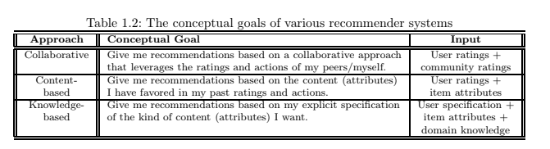

Slide 13
Applications of recommendation system
1. E-Commerce Is an industry where recommendation systems were first widely used. With millions of customers and data on their online behavior, e-commerce companies are best suited to generate accurate recommendations.
2. Retail
Target scared shoppers back in the 2000s when Target systems were able to predict pregnancies even before mothers realized their own pregnancies. Shopping data is the most valuable data as it is the most direct data point on a customer’s intent. Retailers with troves of shopping data are at the forefront of companies making accurate recommendations.
3. Media
Similar to e-commerce, media businesses are one of the first to jump into recommendations. It is difficult to see a news site without a recommendation system.
4. Banking
A mass-market product that is consumed digitally by millions. Banking for the masses and SMEs are prime for recommendations. Knowing a customer’s detailed financial situation, along with their past preferences, coupled with data of thousands of similar users, is quite powerful.
5. Telecom
It Shares similar dynamics with banking. Telcos have access to millions of customers whose every interaction is recorded. Their product range is also rather limited compared to other industries, making recommendations in telecom an easier problem.
6. Utilities
Similar dynamics with telecom, but utilities have an even narrower range of products, making recommendations rather simple.

Slide 14
Problems with Recommendation System
Data Sparsity. Data sparsity is a common issue in recommendation systems where there are many users and items, but only a small number of them interact with each other. ...
Cold Start Problem. ...
Scalability. ...
Overfitting. ...
Diversity. ...
Privacy
Notes:
https://www.itconvergence.com/blog/challenges-and-solutions-for-building-effective-recommendation-systems/

Slide 15
Matrix operations
Matrix addition,
Multiplication,
Transposition, and
Inverses

Slide 16
What Is Covariance?
Covariance measures the directional relationship between the returns on two assets. A positive covariance means asset returns move together, while a negative covariance means they move inversely.
Covariance is calculated by analyzing at-return surprises (standard deviations from the expected return) or multiplying the correlation between the two random variables by the standard deviation of each variable.
+ive
-ive

